Slide 1
BIIT Attendance System
Group Members: Abdullah Izhar
Ayesha Ishraq
Ahsan Ismail
Muhmmad Saqib Qadeer
Hamza Fayyaz
Supervisor: Mr. Zahid

Slide 2
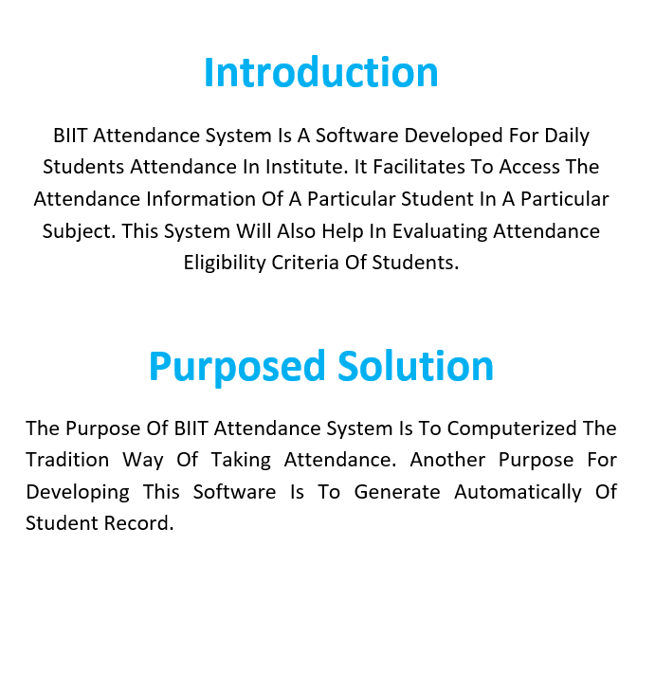

Slide 3
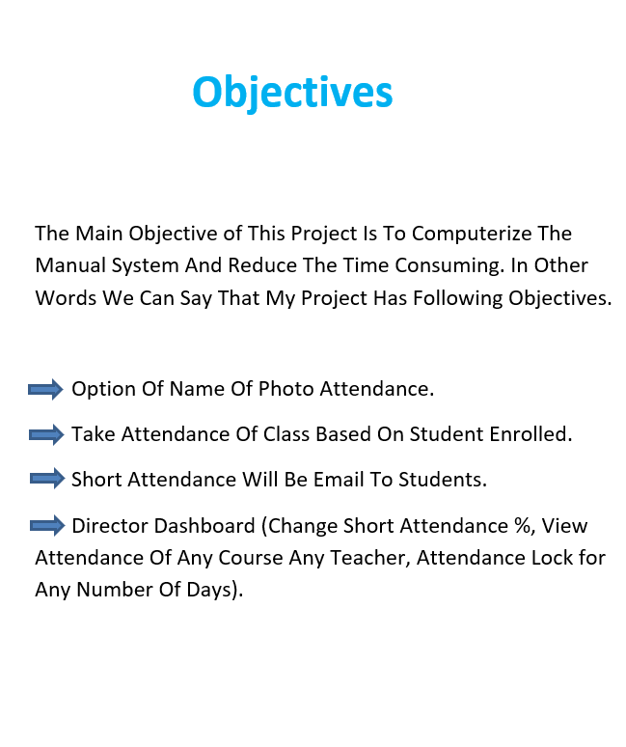

Slide 4
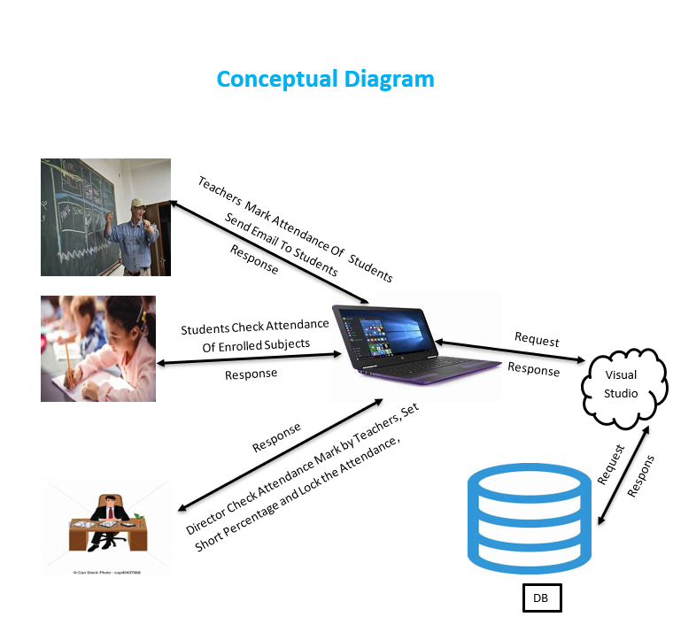

Slide 5
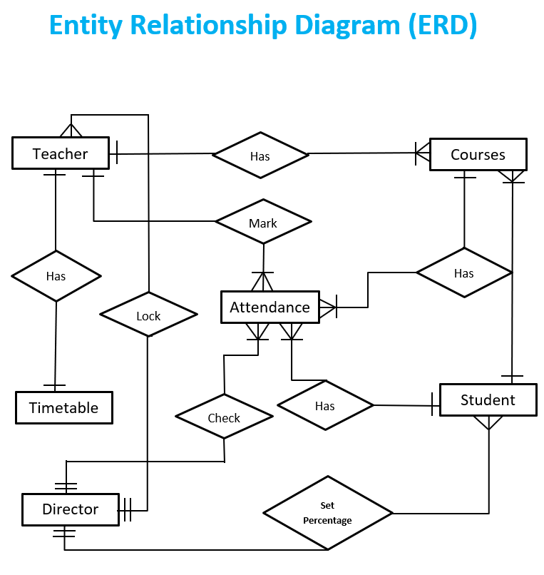

Slide 6
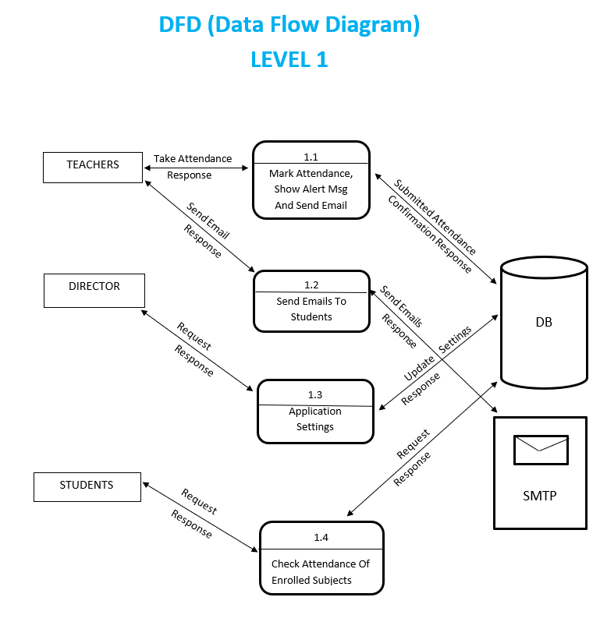

Slide 7
BIIT Attendance System
By
Mirza Abdullah Izhar
18-arid-0255
(React JS)

Slide 8
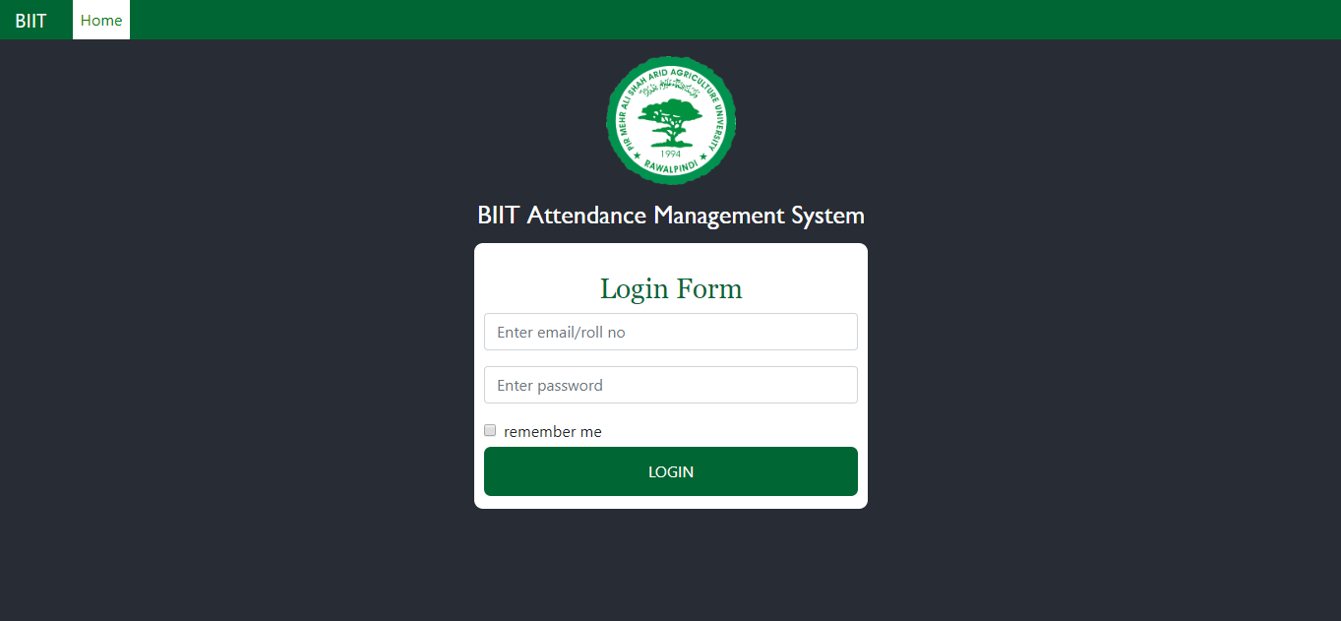
Login Page

Slide 9
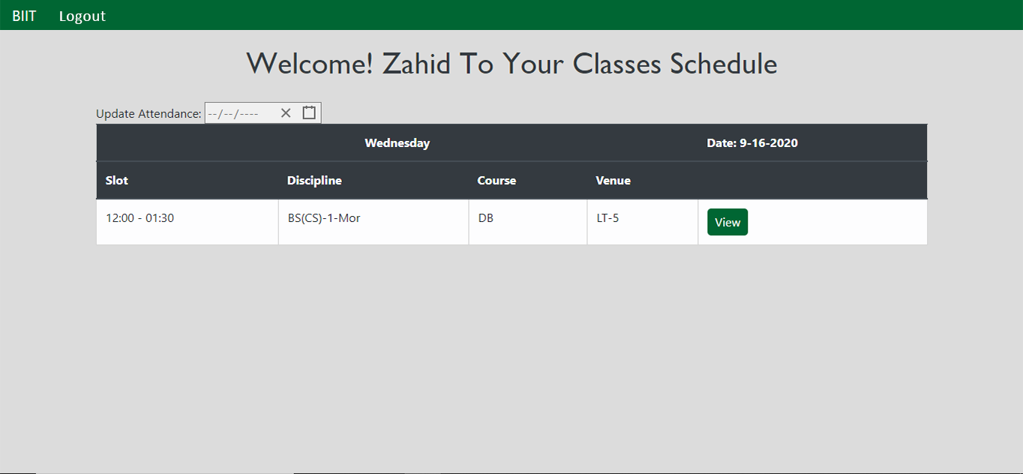
Teacher’s View

Slide 10
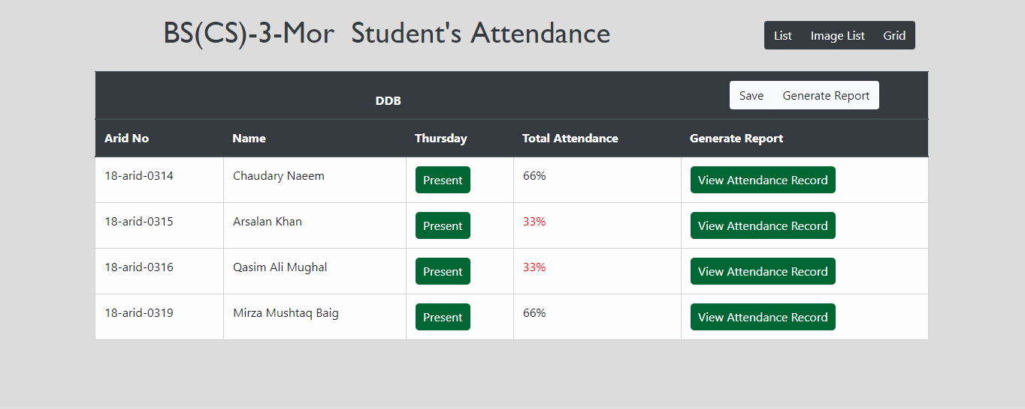
Teacher’s View

Slide 11
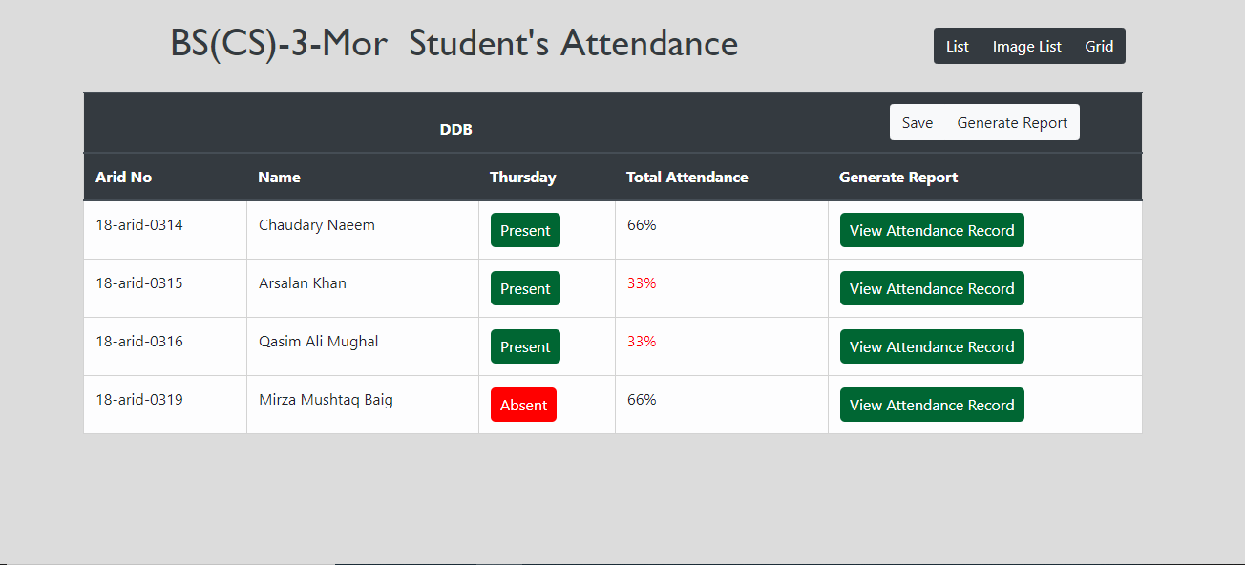
Teacher’s View

Slide 12
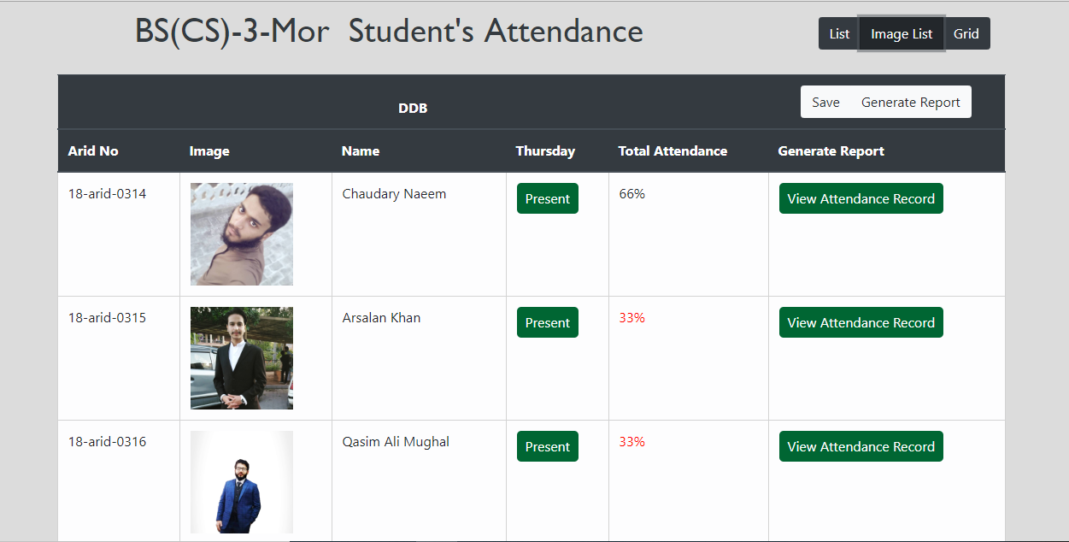
Teacher’s View

Slide 13
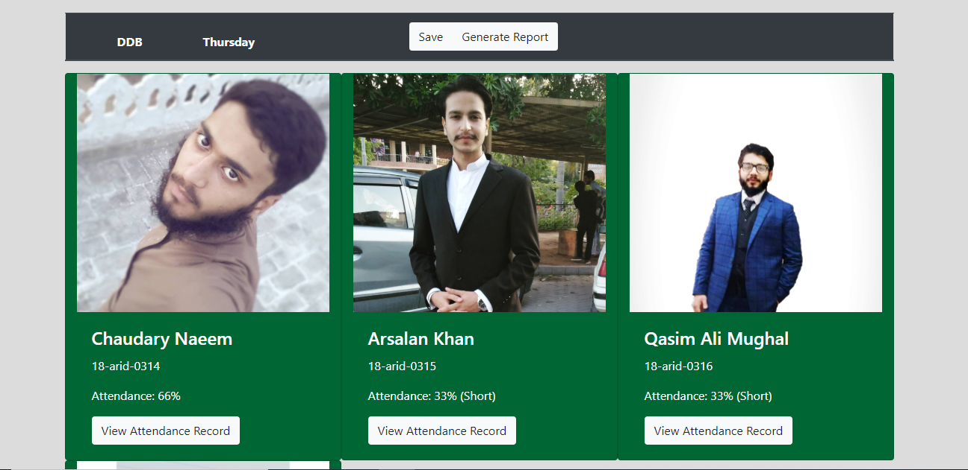
Teacher’s View

Slide 14
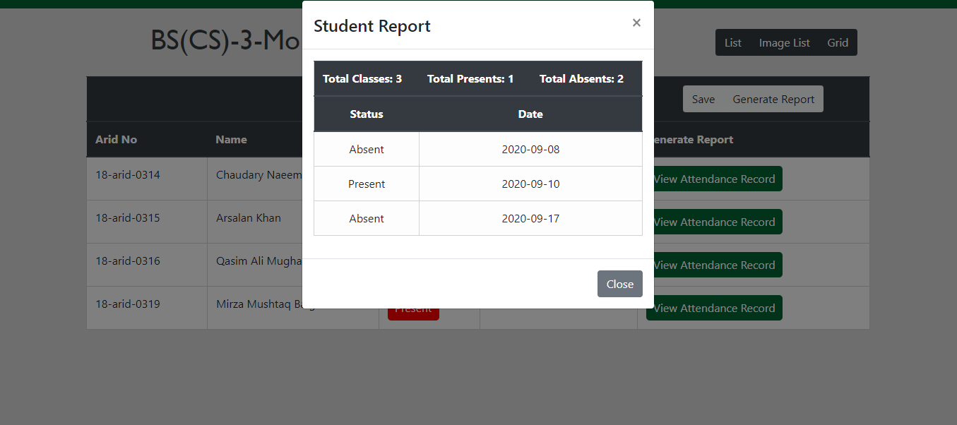
Teacher’s View

Slide 15
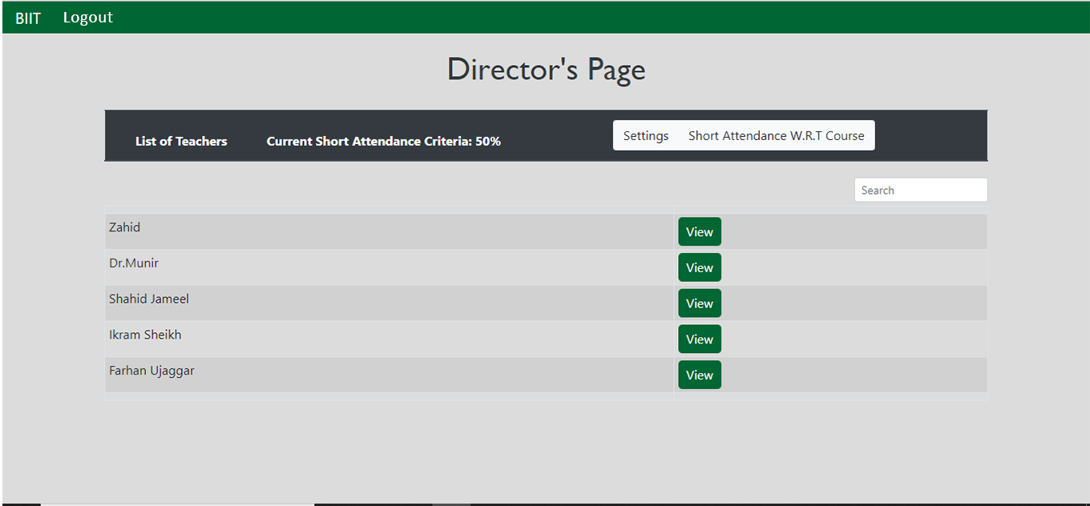
Director’s View

Slide 16
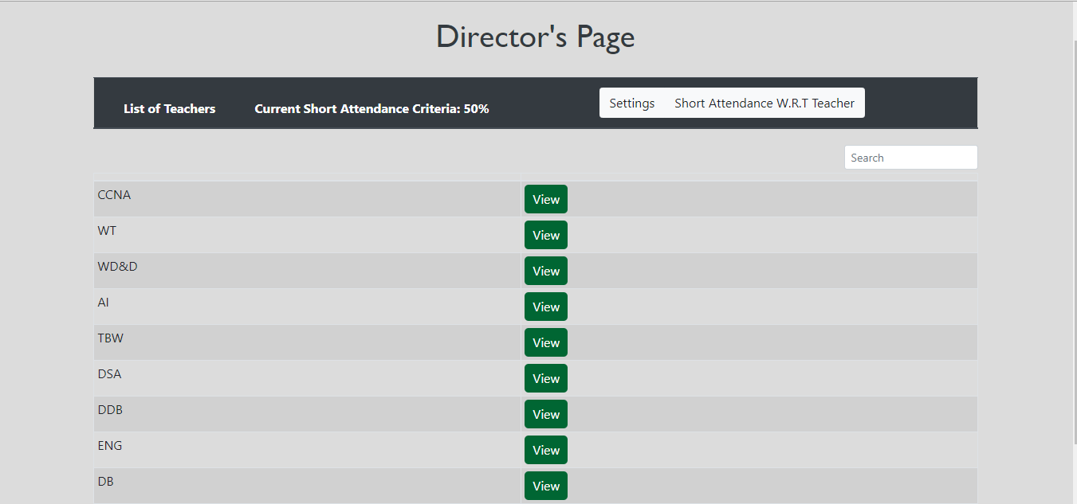
Director’s View

Slide 17
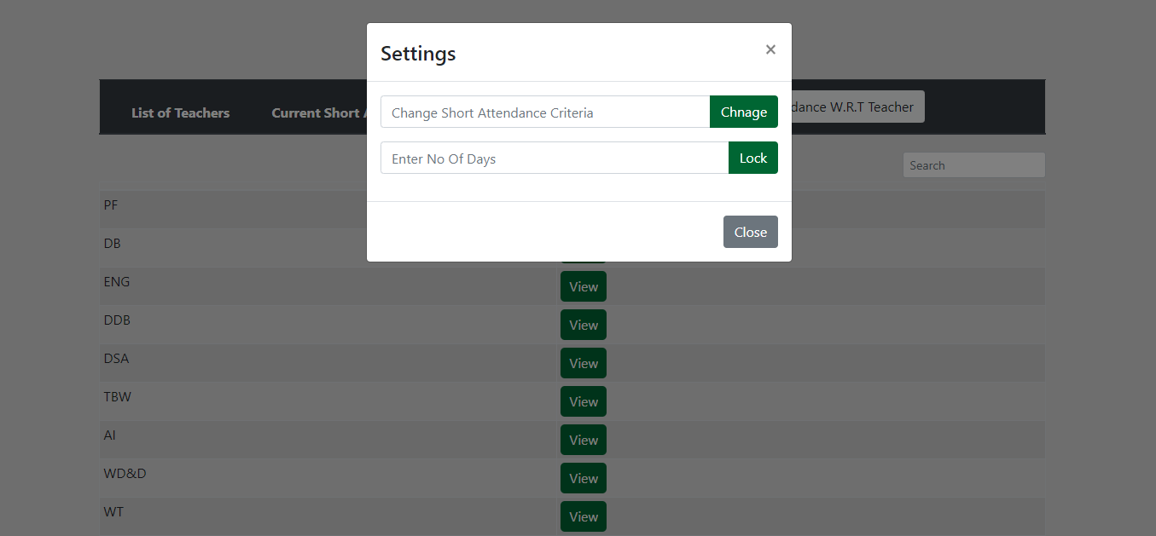
Director’s View

Slide 18
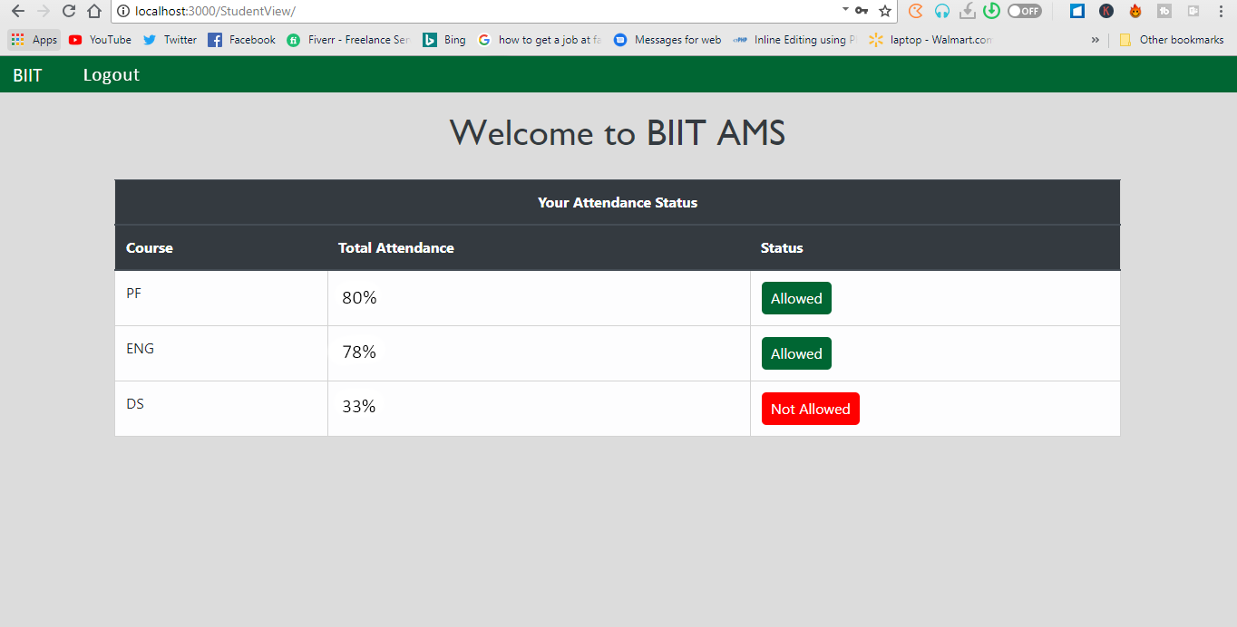
Student’s View

Slide 19
BIIT Attendance System
By
Ayesha Ishraq
16-arid-0054
(iOS)

Slide 20
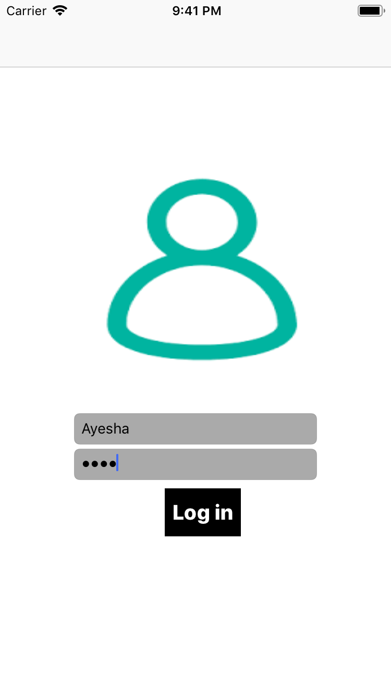
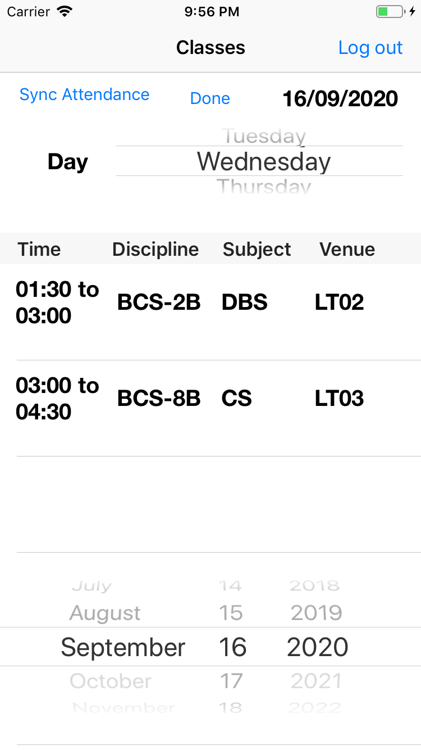
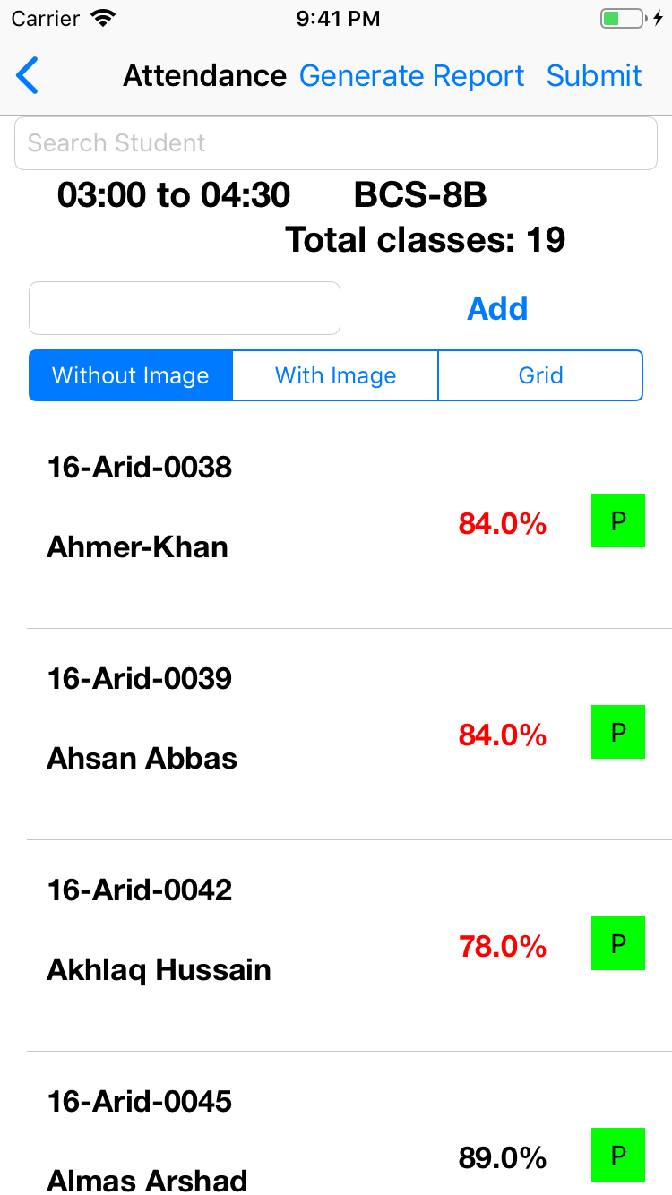
Teacher Screens

Slide 21
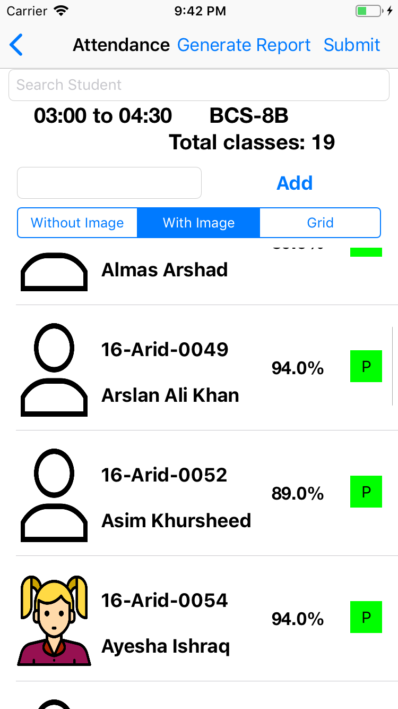
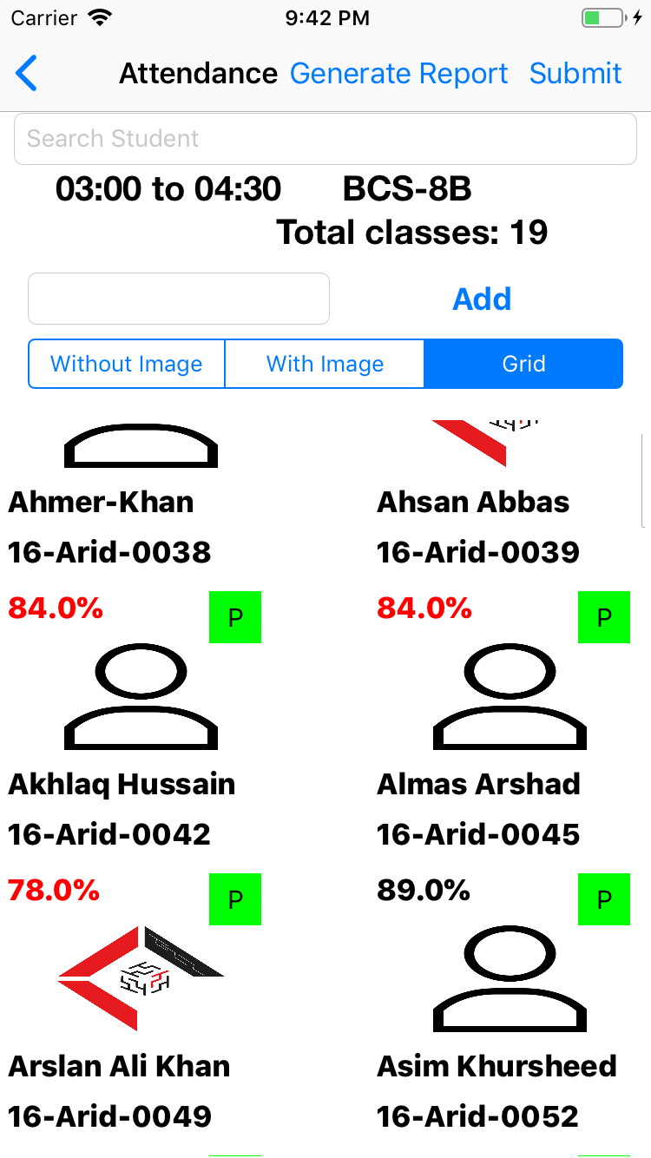
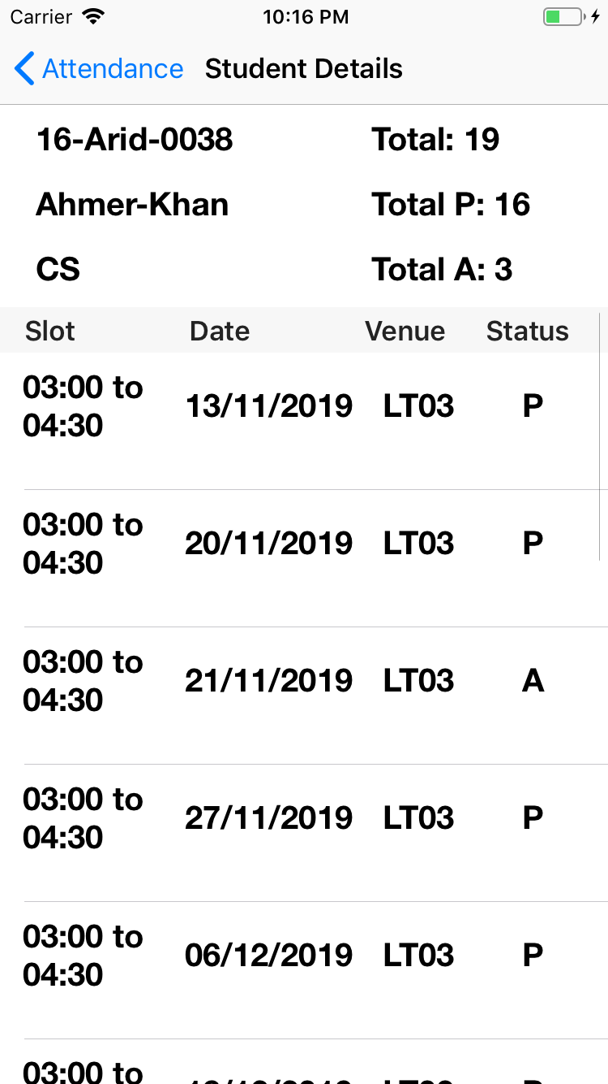
Teacher Screens

Slide 22
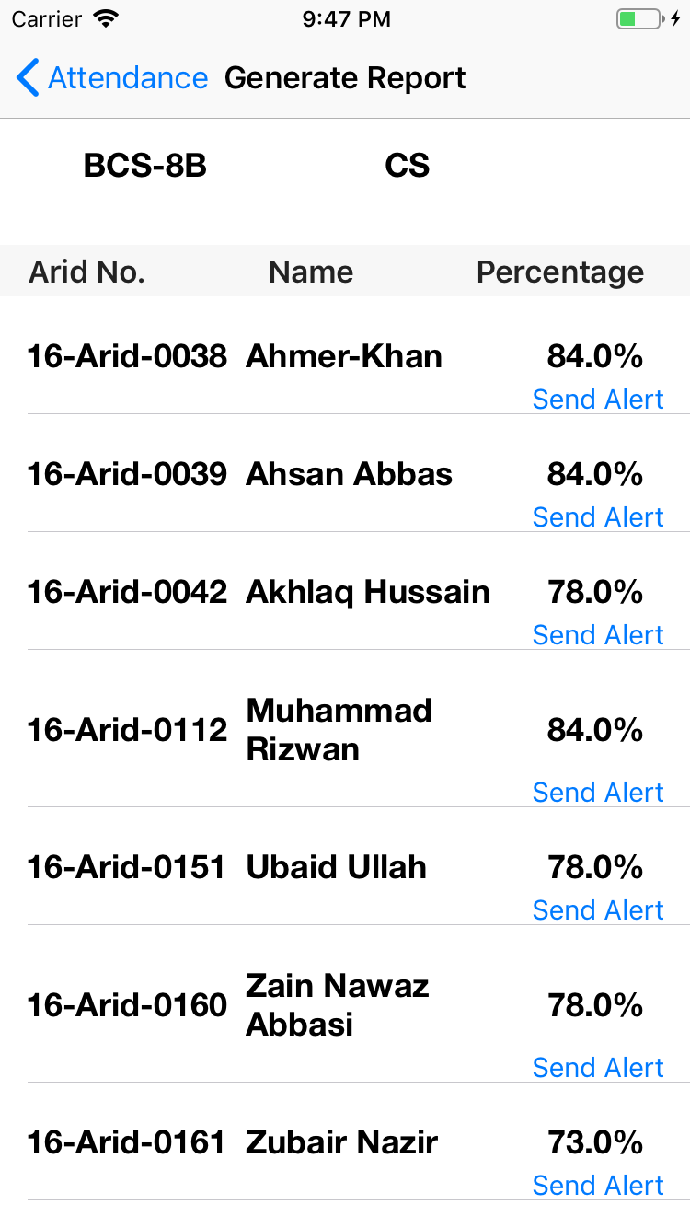
Teacher Screens (Generate Report)

Slide 23

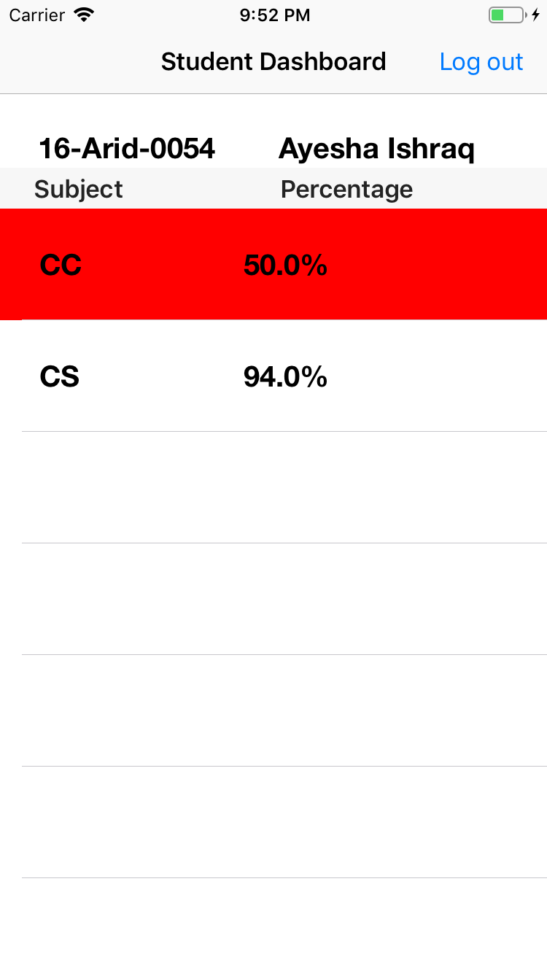
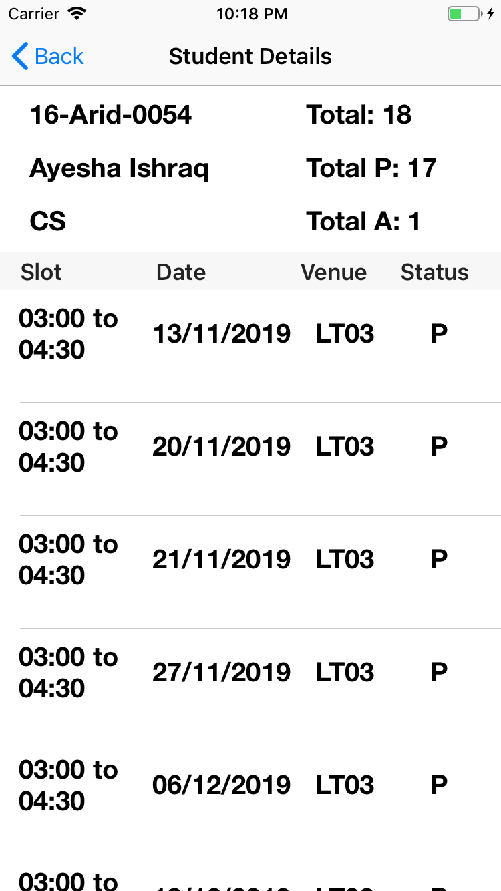
Student Screens

Slide 24

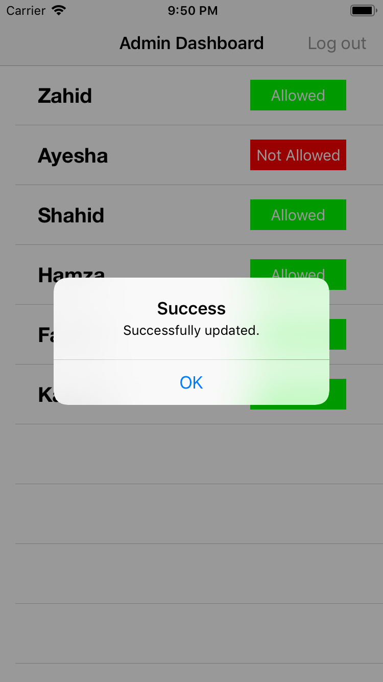
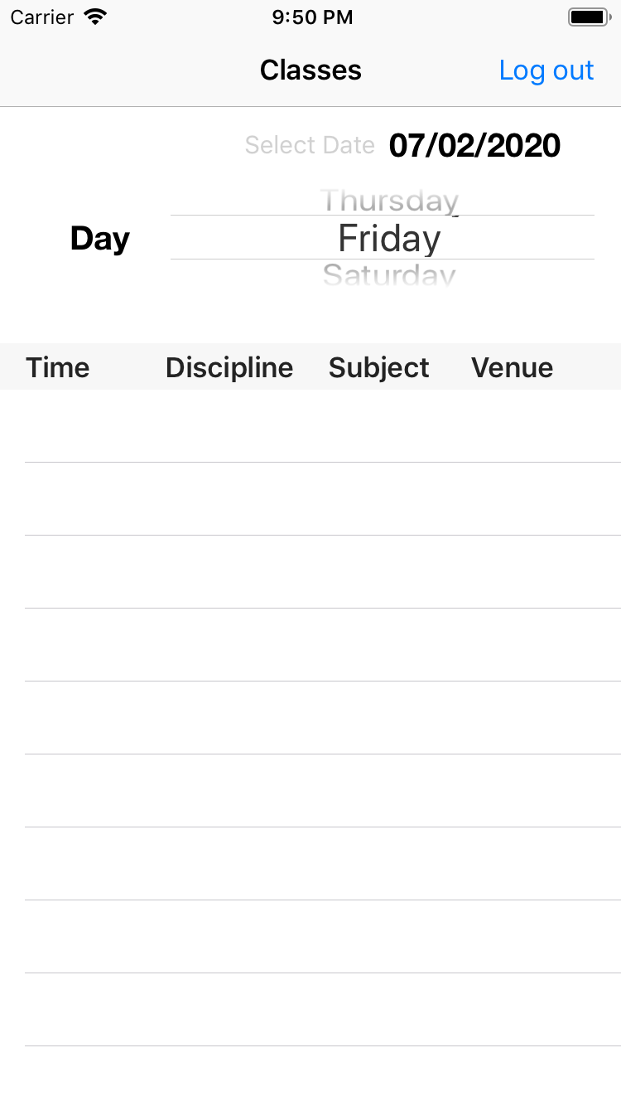
Admin Screens

Slide 25

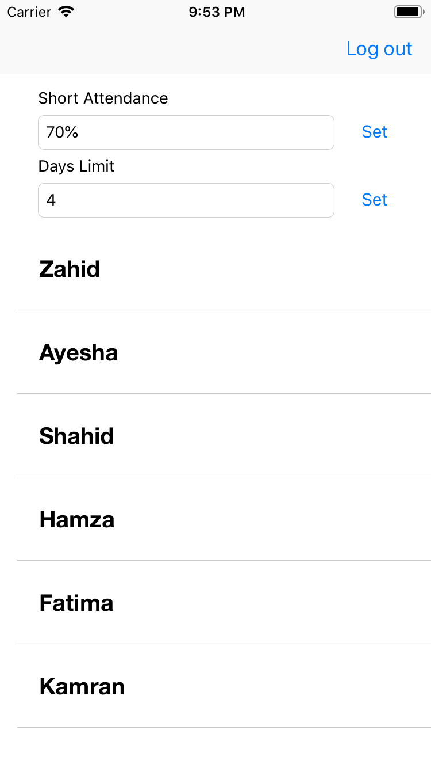
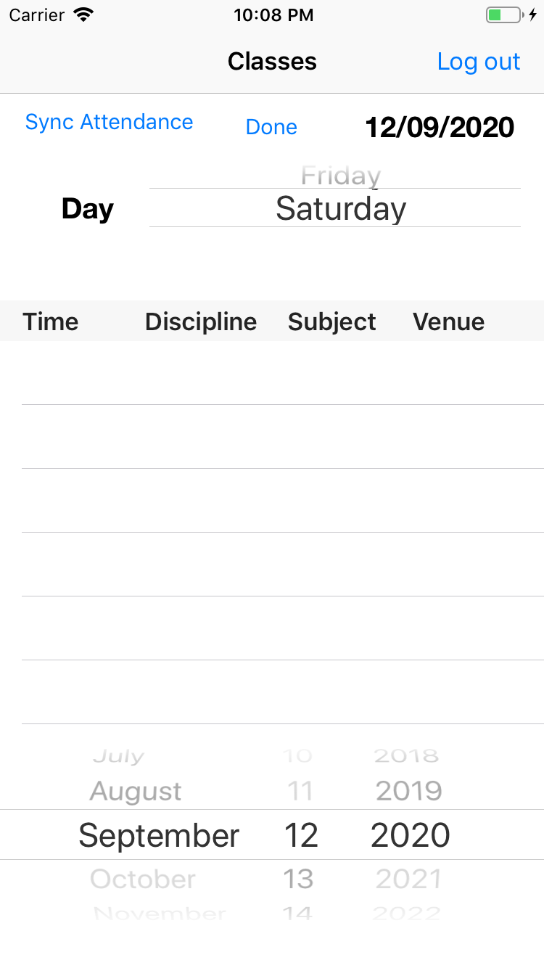
Director Screens

Slide 26
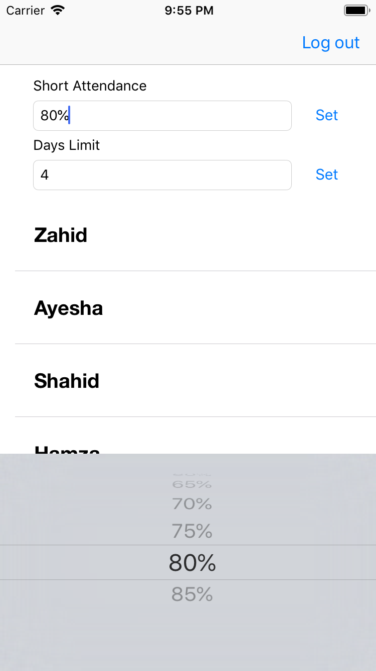
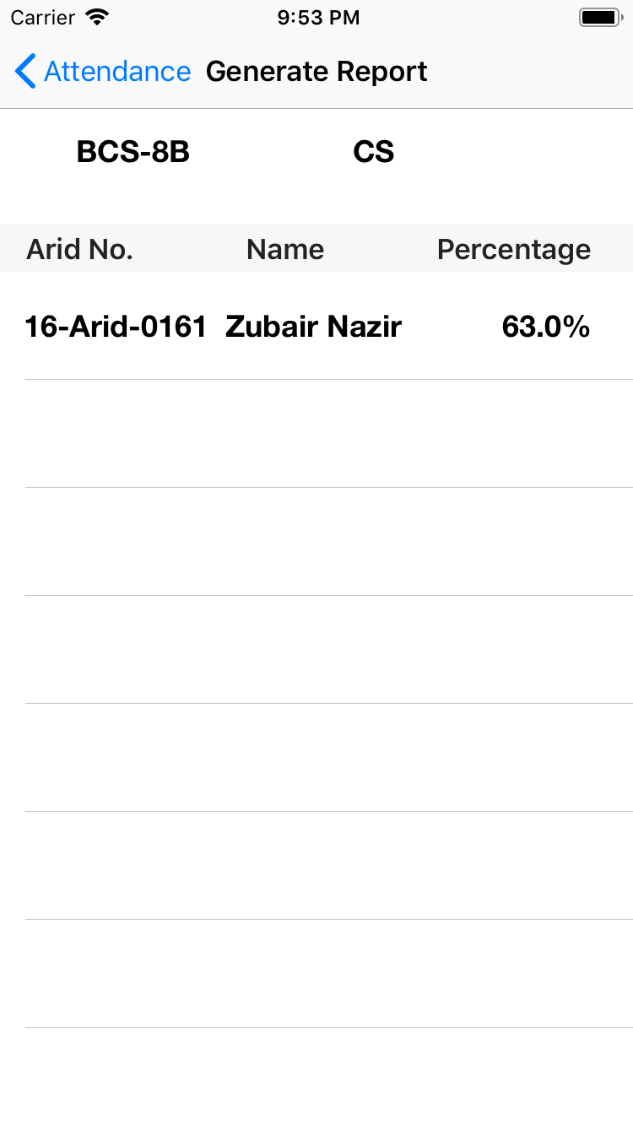
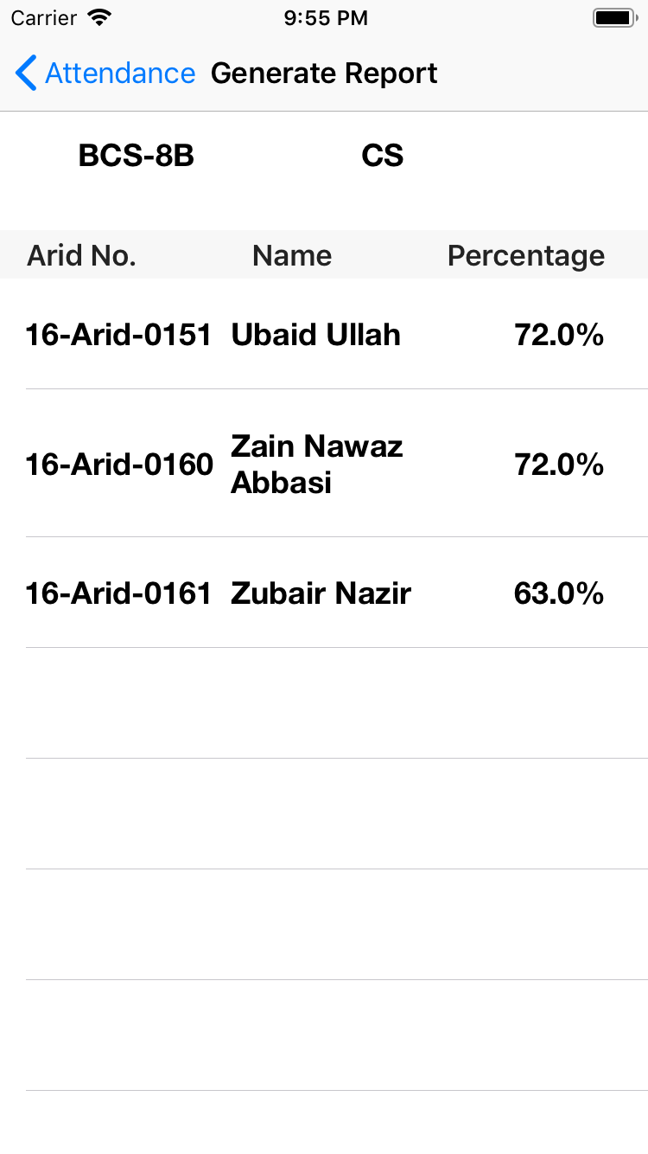
Director Screens

Slide 27
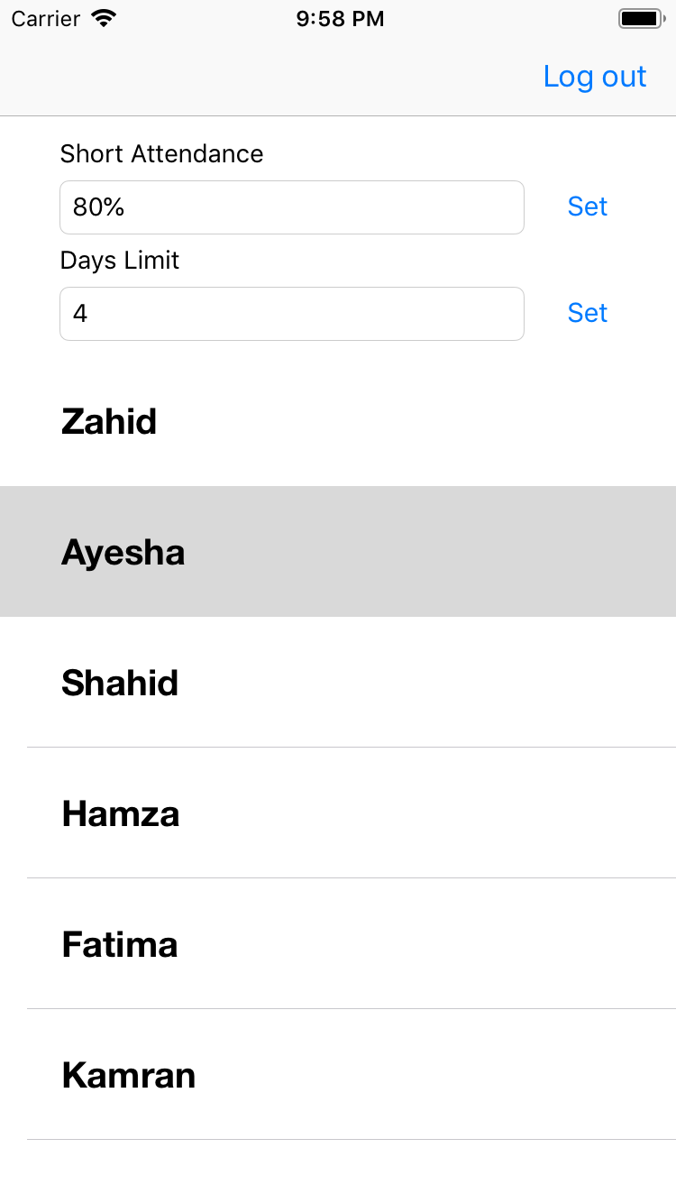
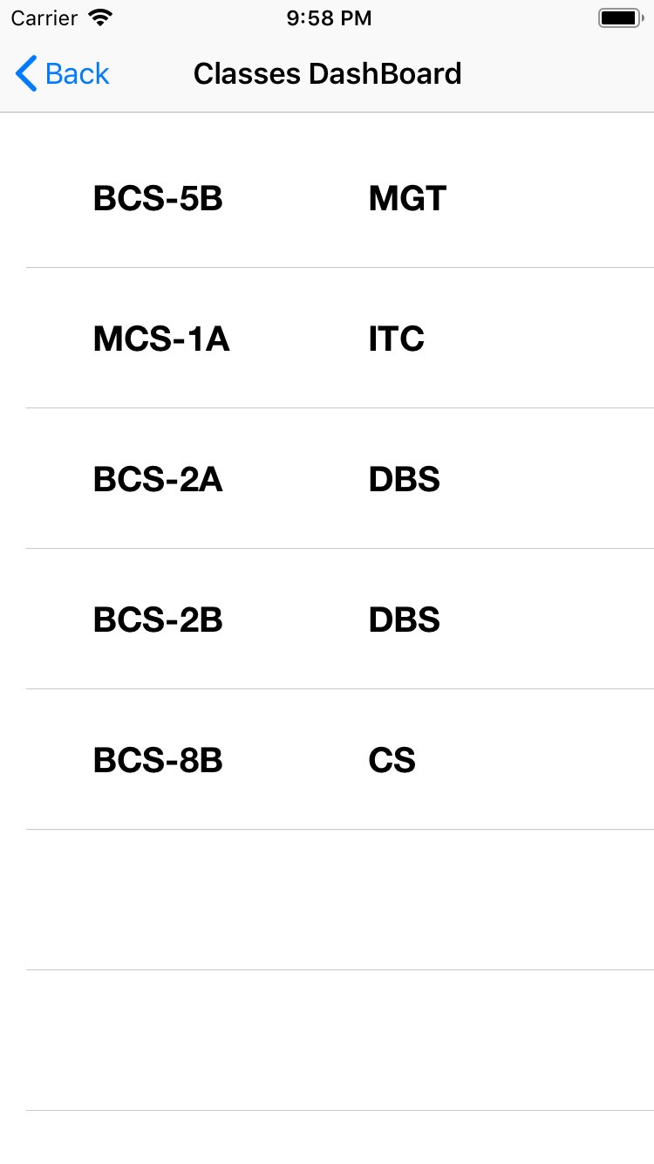
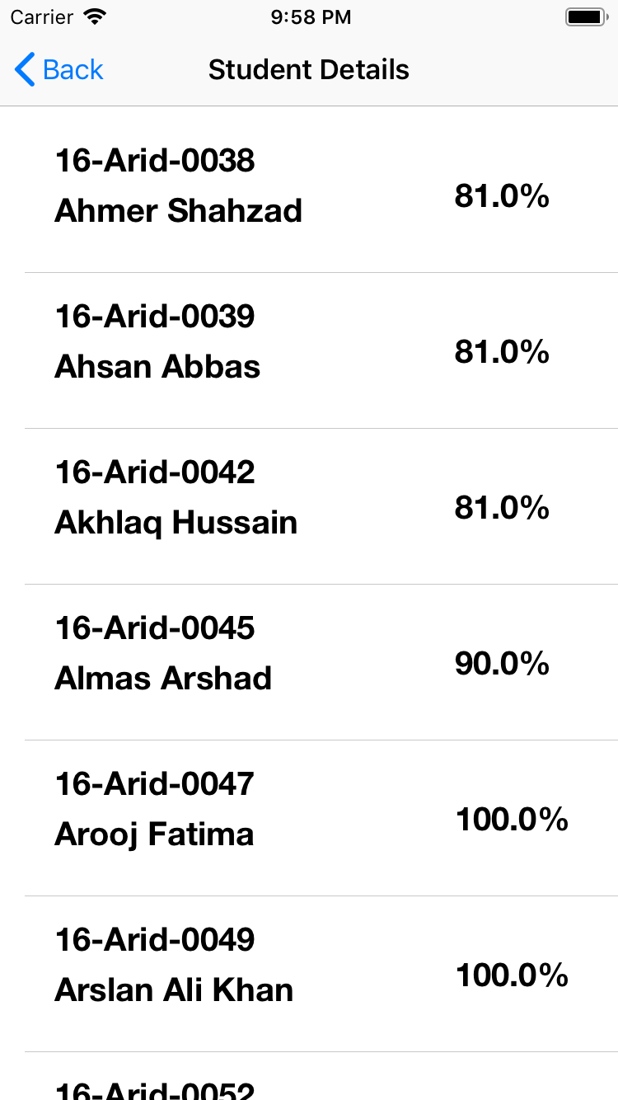
Director Screens

Slide 28
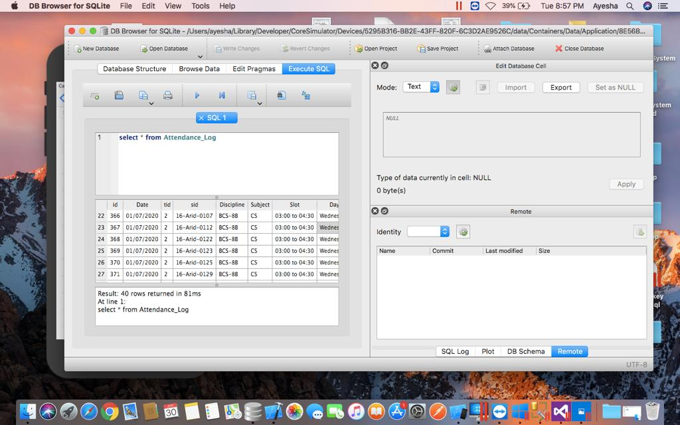
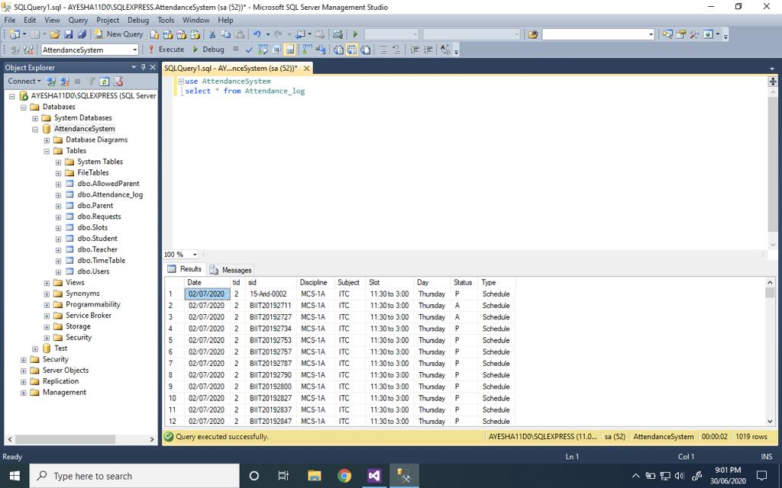
Auto Sync Attendance
When Offline
When Online

Slide 29
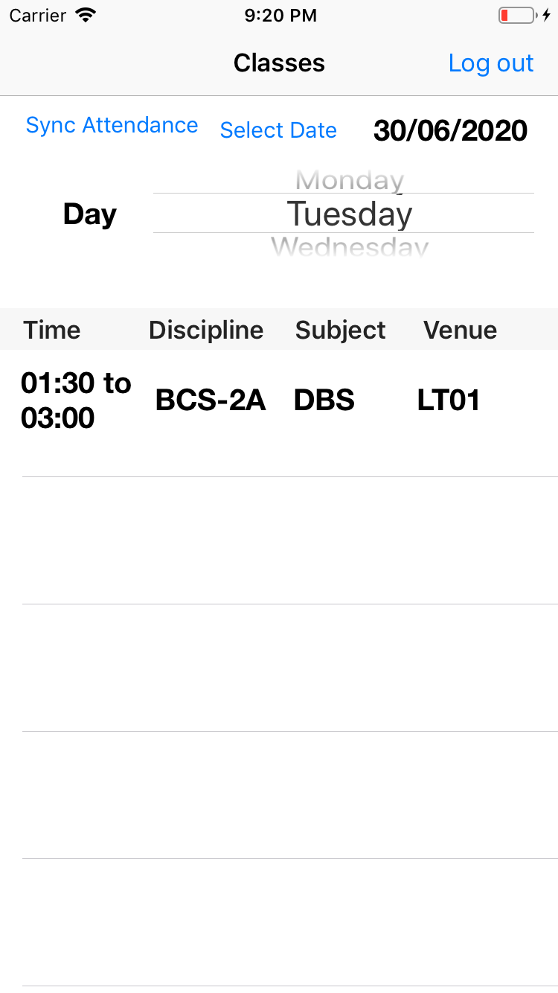
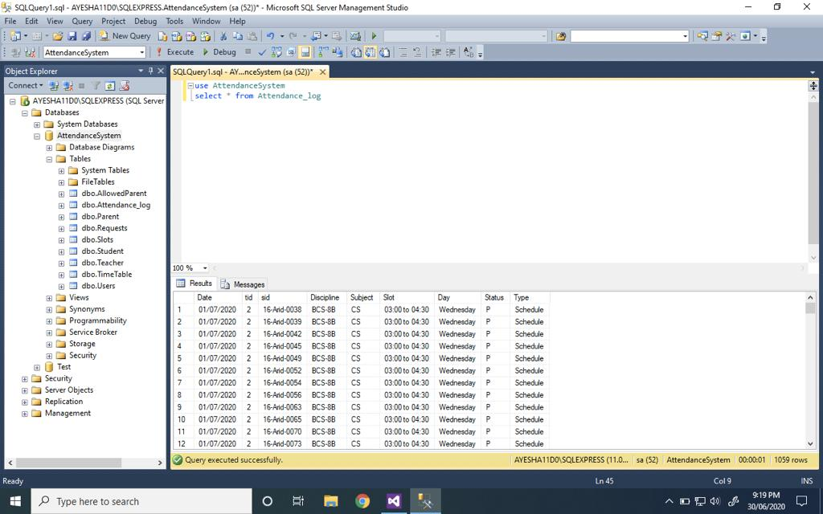

Slide 30
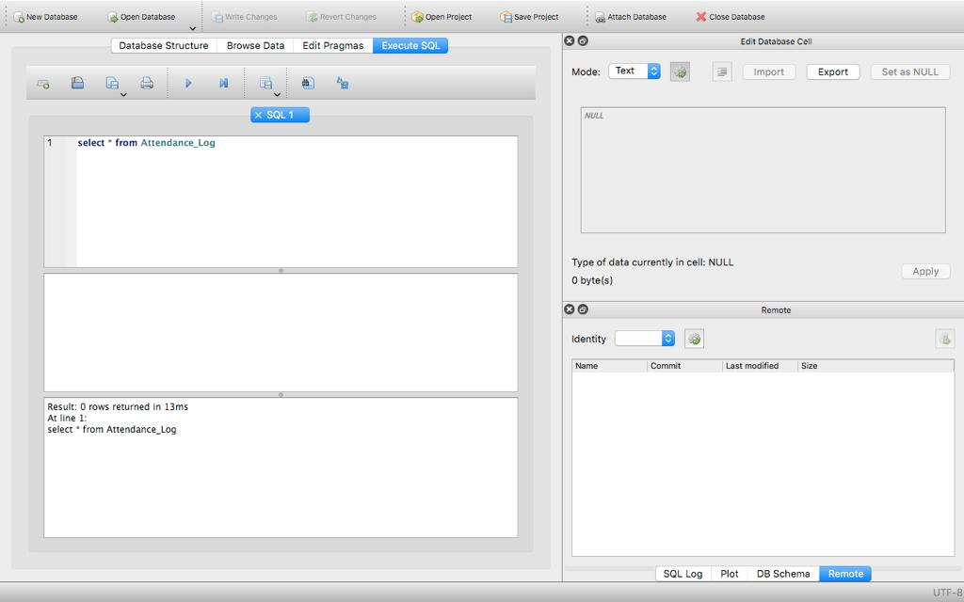

Slide 31
BIIT Attendance System
By
Ahsan Ismail
16-arid-2132
(Android)

Slide 32
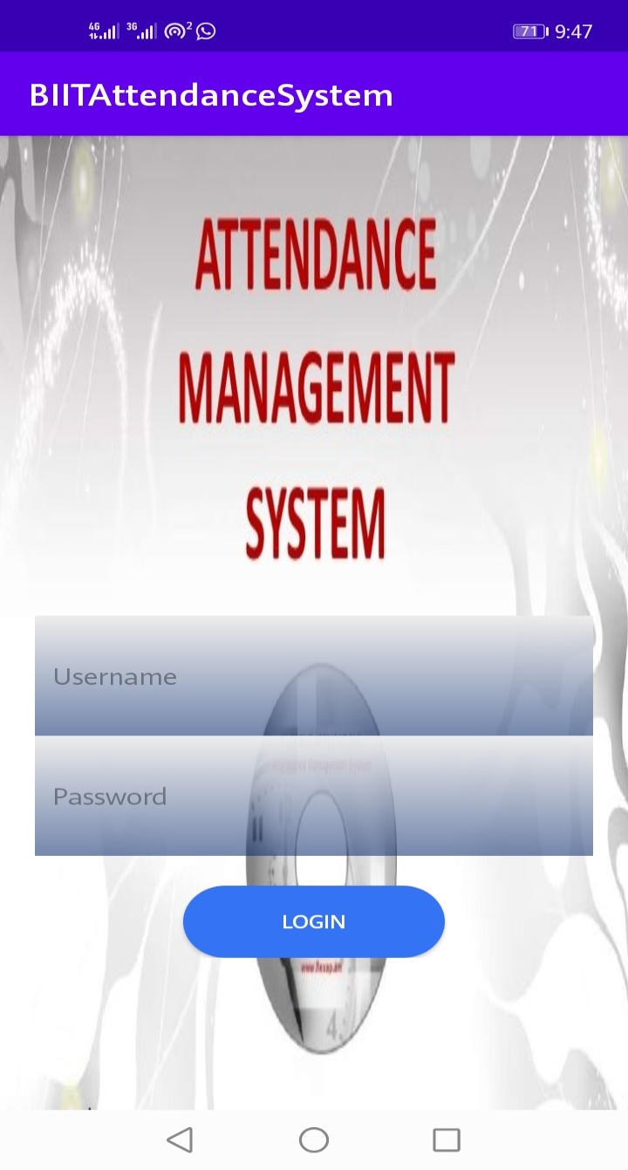
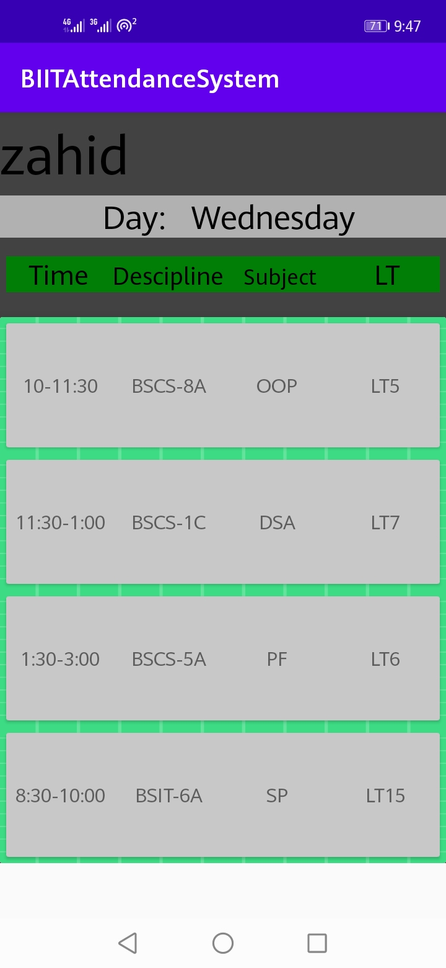
Teacher Side

Slide 33
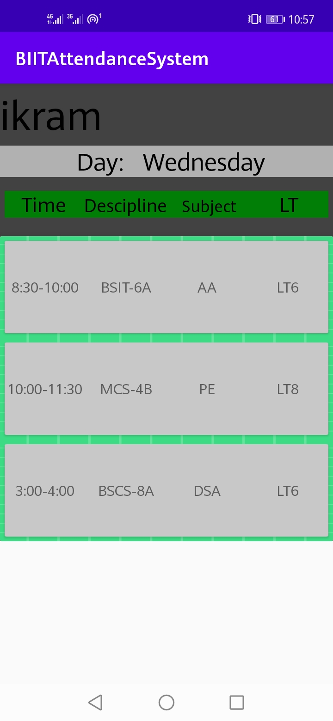
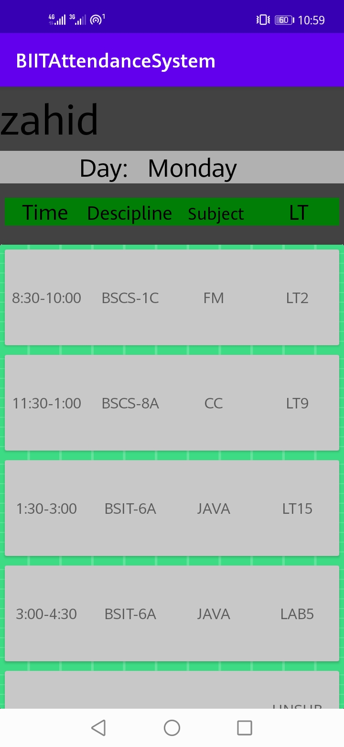

Slide 34
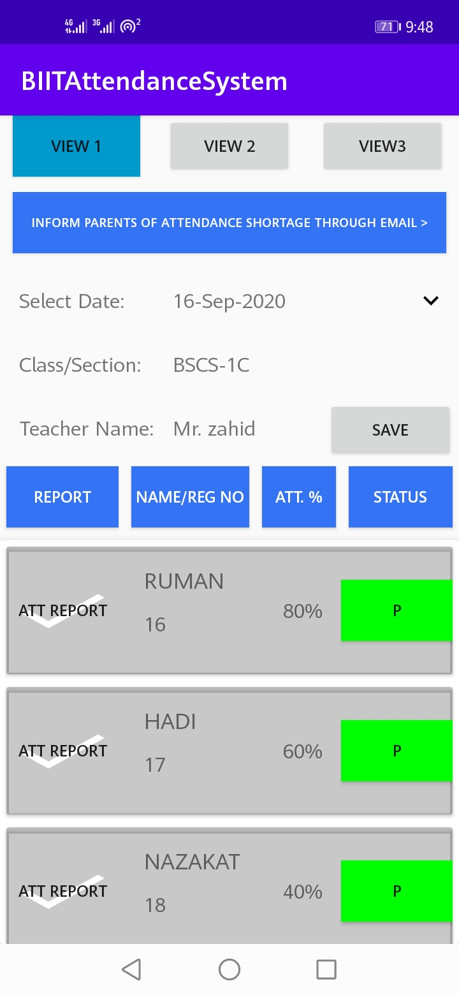
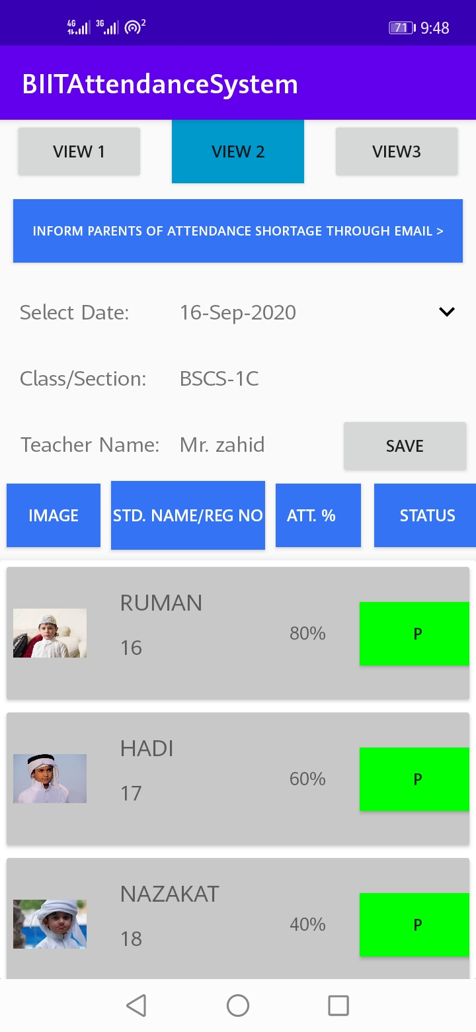

Slide 35
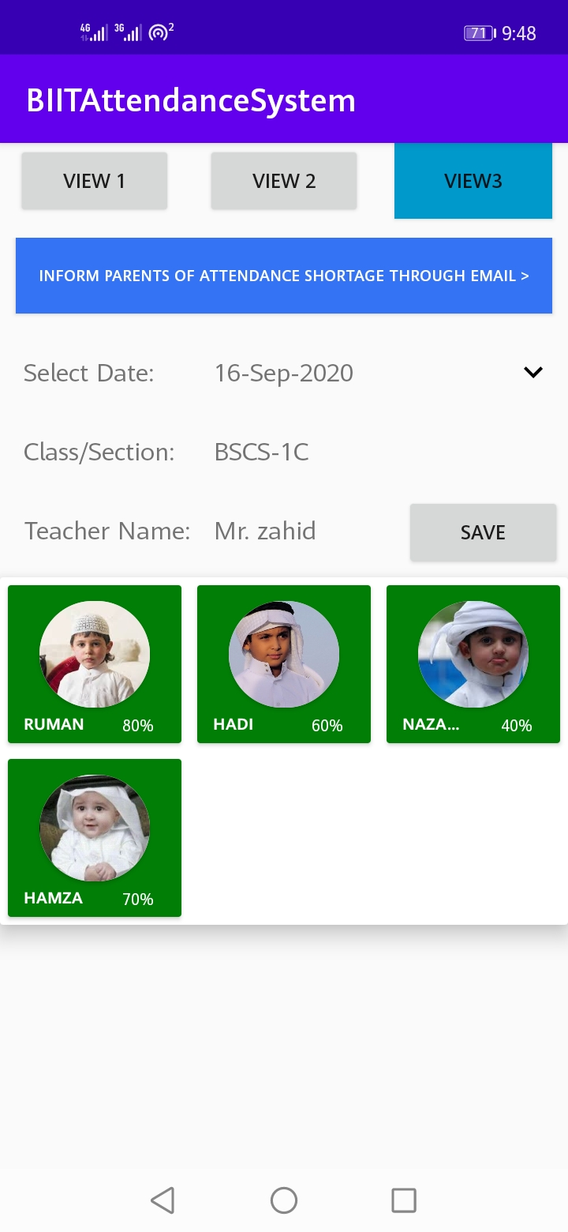
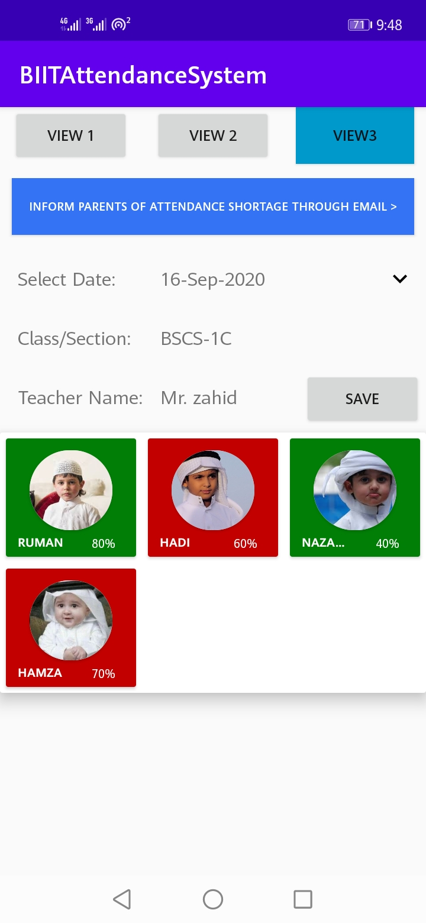

Slide 36
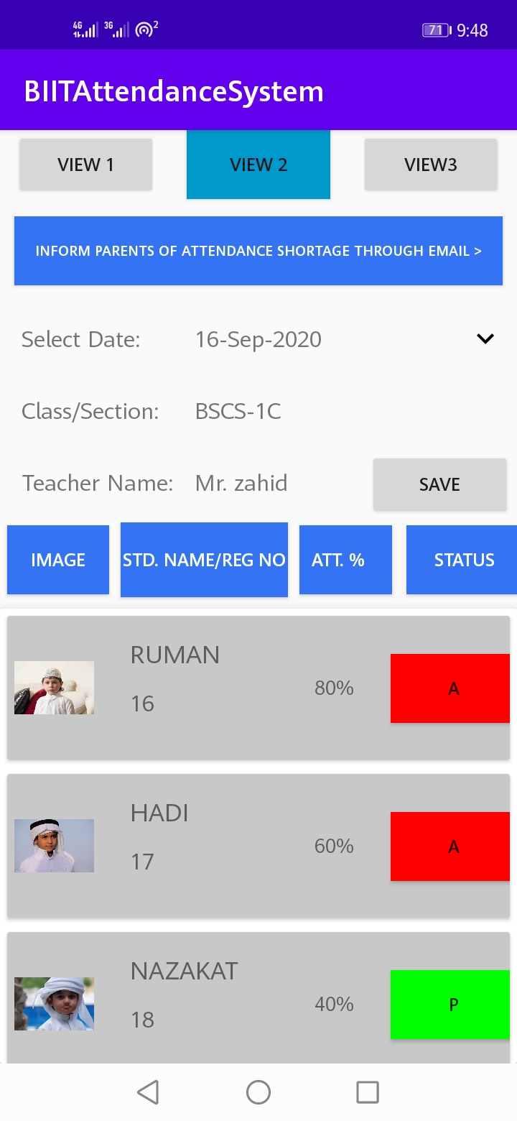

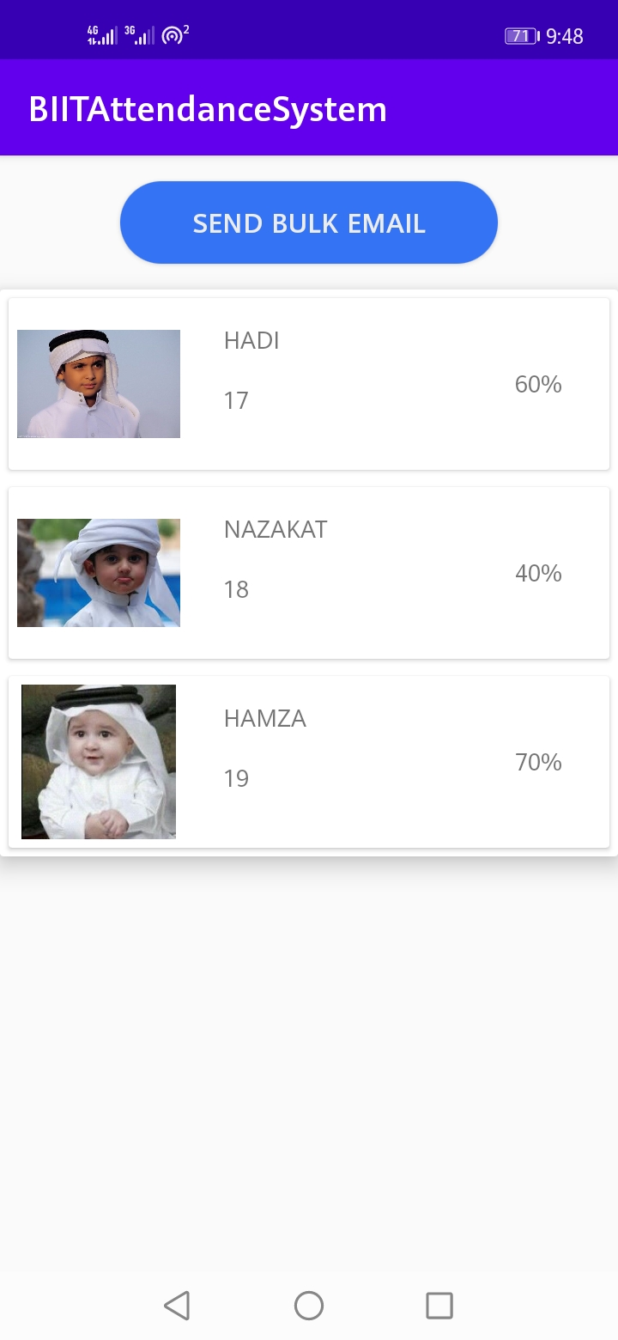

Slide 37


Admin Side

Slide 38



Slide 39




Slide 40
BIIT Attendance System
By
Muhammad Saqib Qadeer Rana
18-arid-1382
(C#)

Slide 41

Project Screenshots….. Director Side

Slide 42


Slide 43

Teachers Side

Slide 44


Slide 45


Slide 46

Update Attendance

Slide 47


Slide 48

Attendance With Photo View

Slide 49

Students Side

Slide 50
BIIT Attendance System
By
Hamza Fayyaz
16-arid-0069
(React-Native)

Slide 51


Slide 52

Teacher’s View(Login Screen)

Slide 53


Teacher’s View(Daily Schedule)

Slide 54



Teacher’s View(Attendance Views)

Slide 55

Teacher’s View (Student Attendance Detail)

Slide 56


Teacher’s View (Short Attendance & Message)

Slide 57


Teacher’s View (Attendance Submit & Update)

Slide 58


Teacher’s View (Offline Attendance)

Slide 59

Student’s View (Login)

Slide 60



Student’s View (Attendance Report)

Slide 61

Admin’s View (Login)

Slide 62


Admin’s View (Short Attendance Percentage)

Slide 63


Admin’s View (Attendance Lock)

Slide 64



Admin’s View (Search Course)

Slide 65
Thank You

